Slide 1

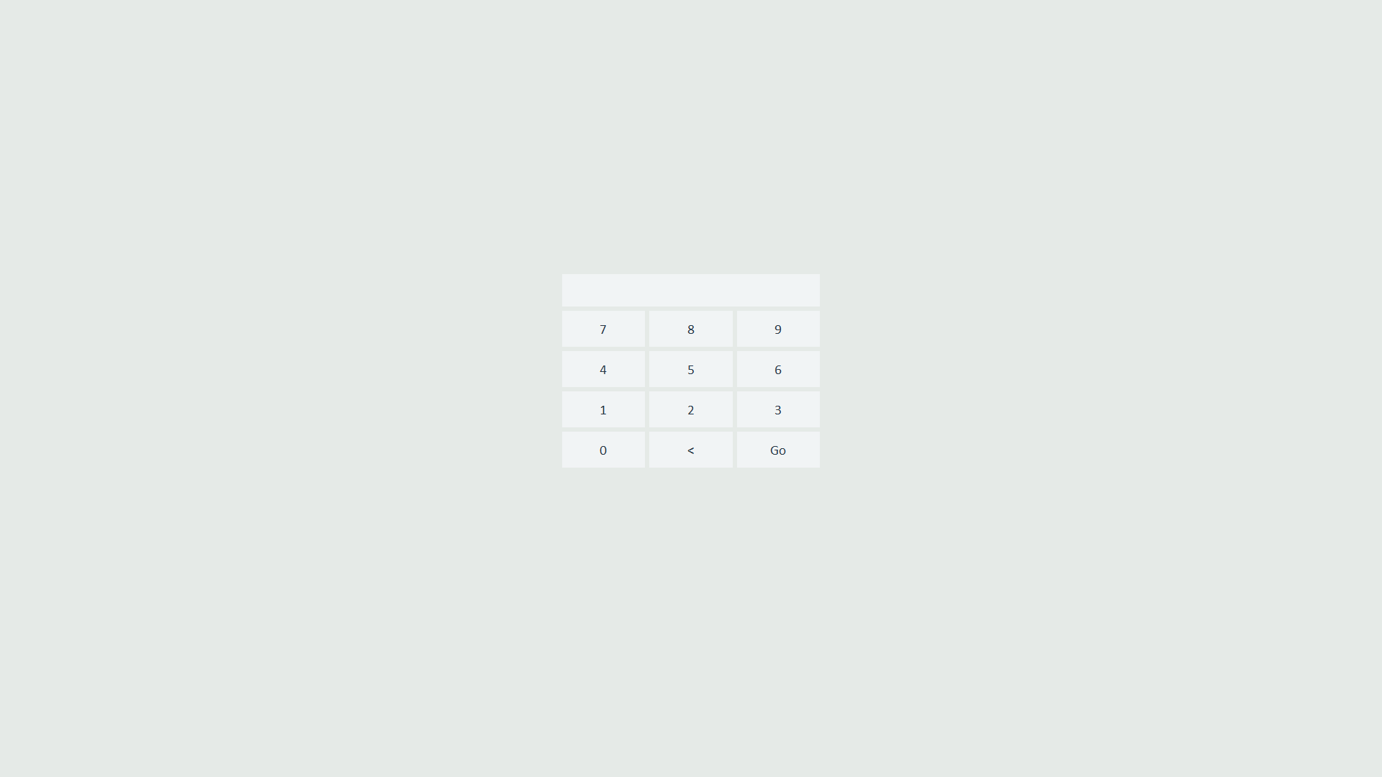
Enter a Admin ID

Slide 2
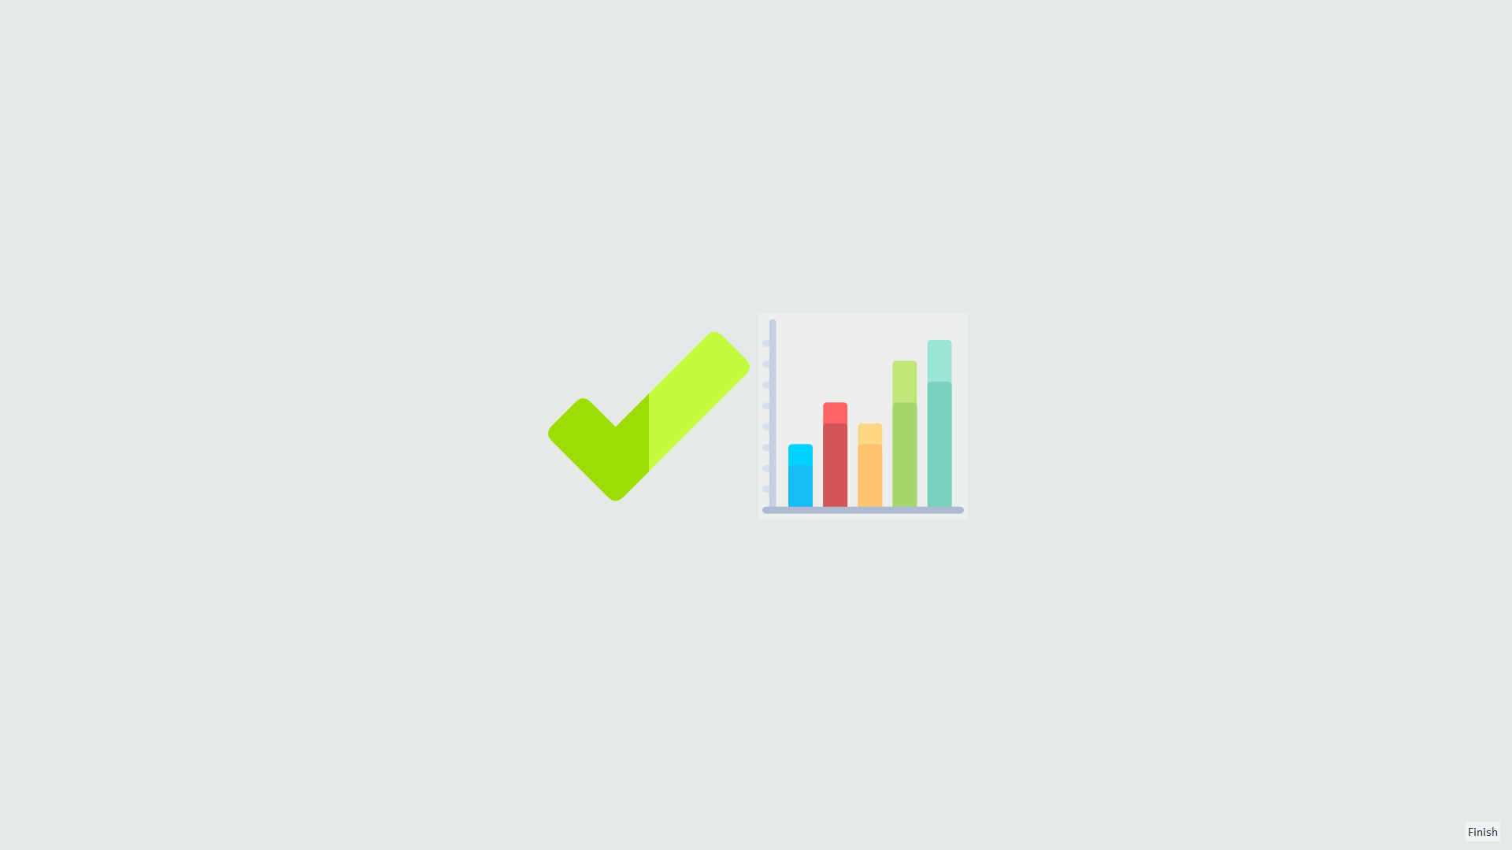
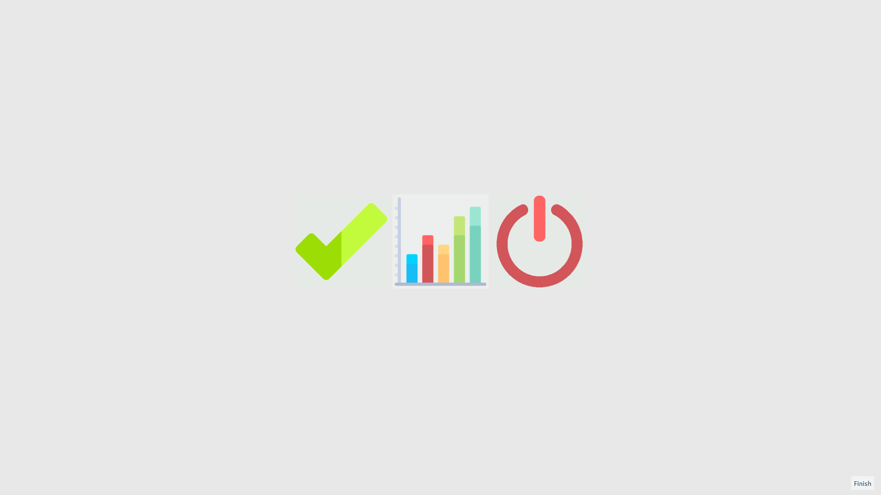
Click here to visit the Admin menu
Note this is only displayed when you login with an Admin account.

Slide 3
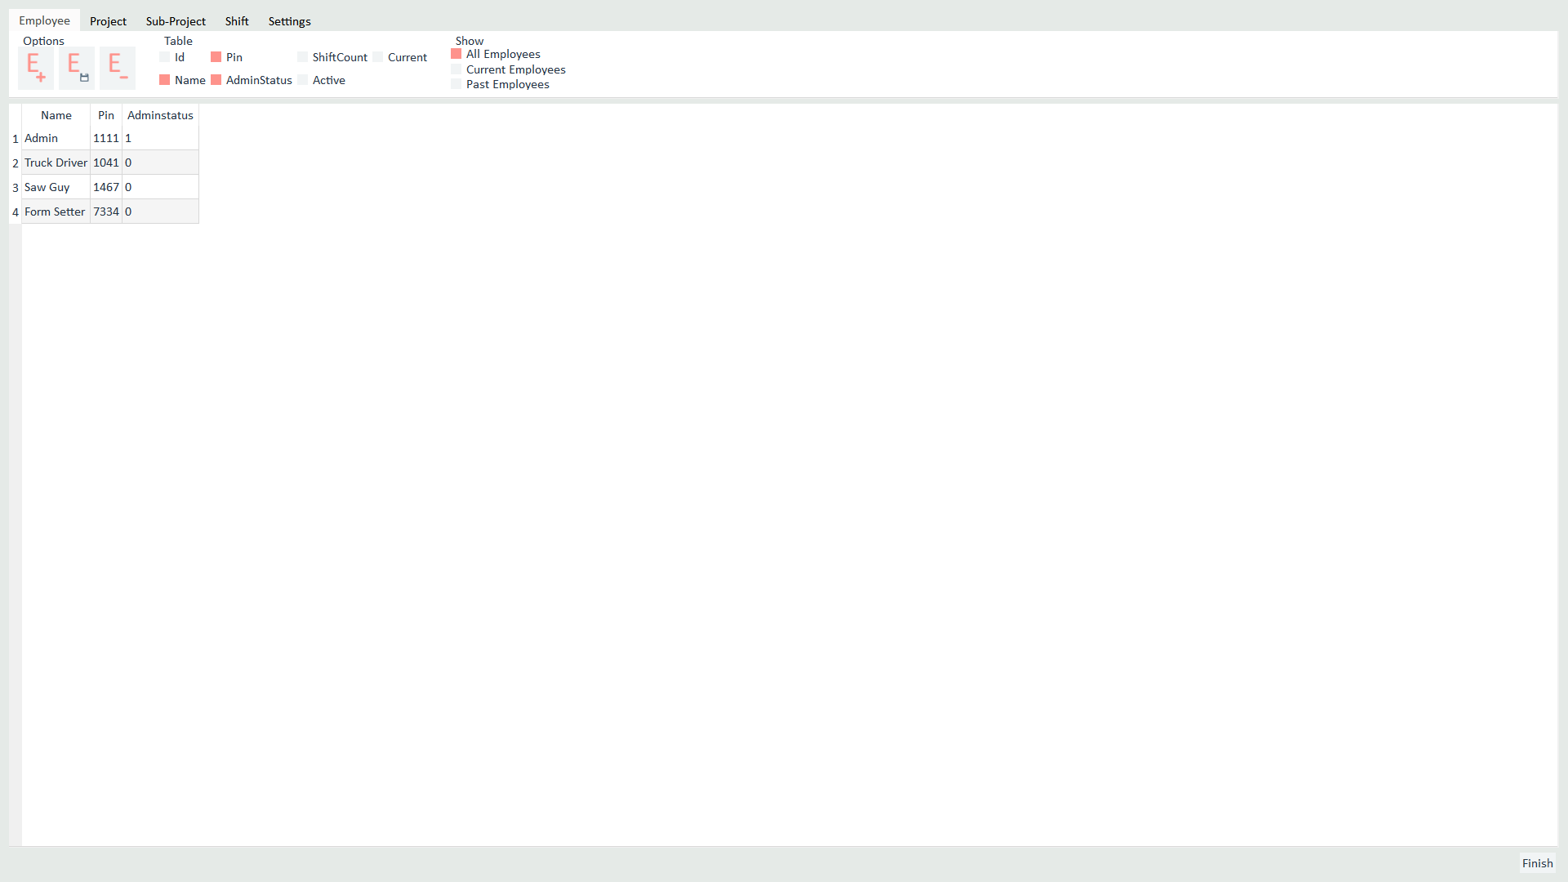
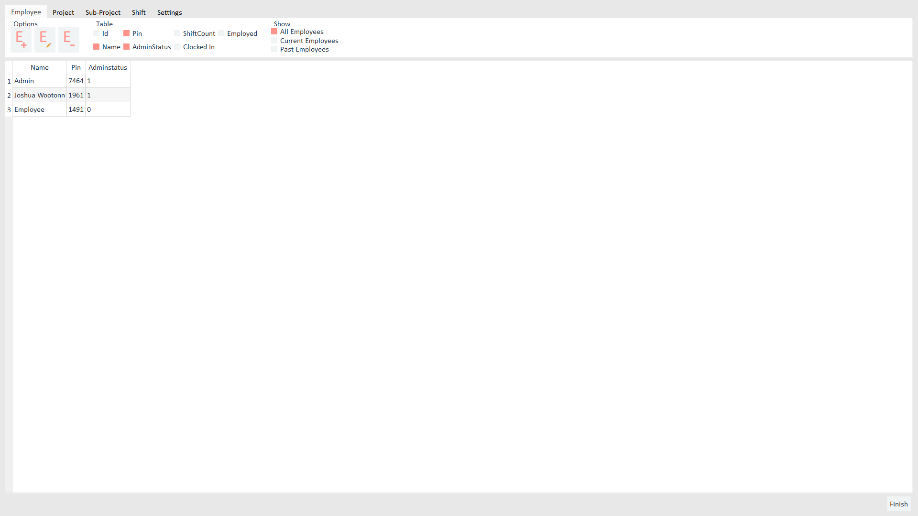
The Admin menu has 5 sections
Employee
Project
Sub-Project
Shift
Settings
Click any of the tabs to navigate to that section
Click here to exit the Admin menu at any time

Slide 4
Tab one is called Employee
Employees are displayed in the table below

Slide 5
There are three functions in the Employee Section
Add Employee:
Click Add
Fill in blank slate inserted into the table
Edit Employee :
Select Employee by clicking the table
Click Edit
Delete Employee :
Select Employee by clicking the table
Click Delete

Slide 6
The Show options let you select what Employees are displayed
The Table options adjust what Employee properties are displayed

Slide 7
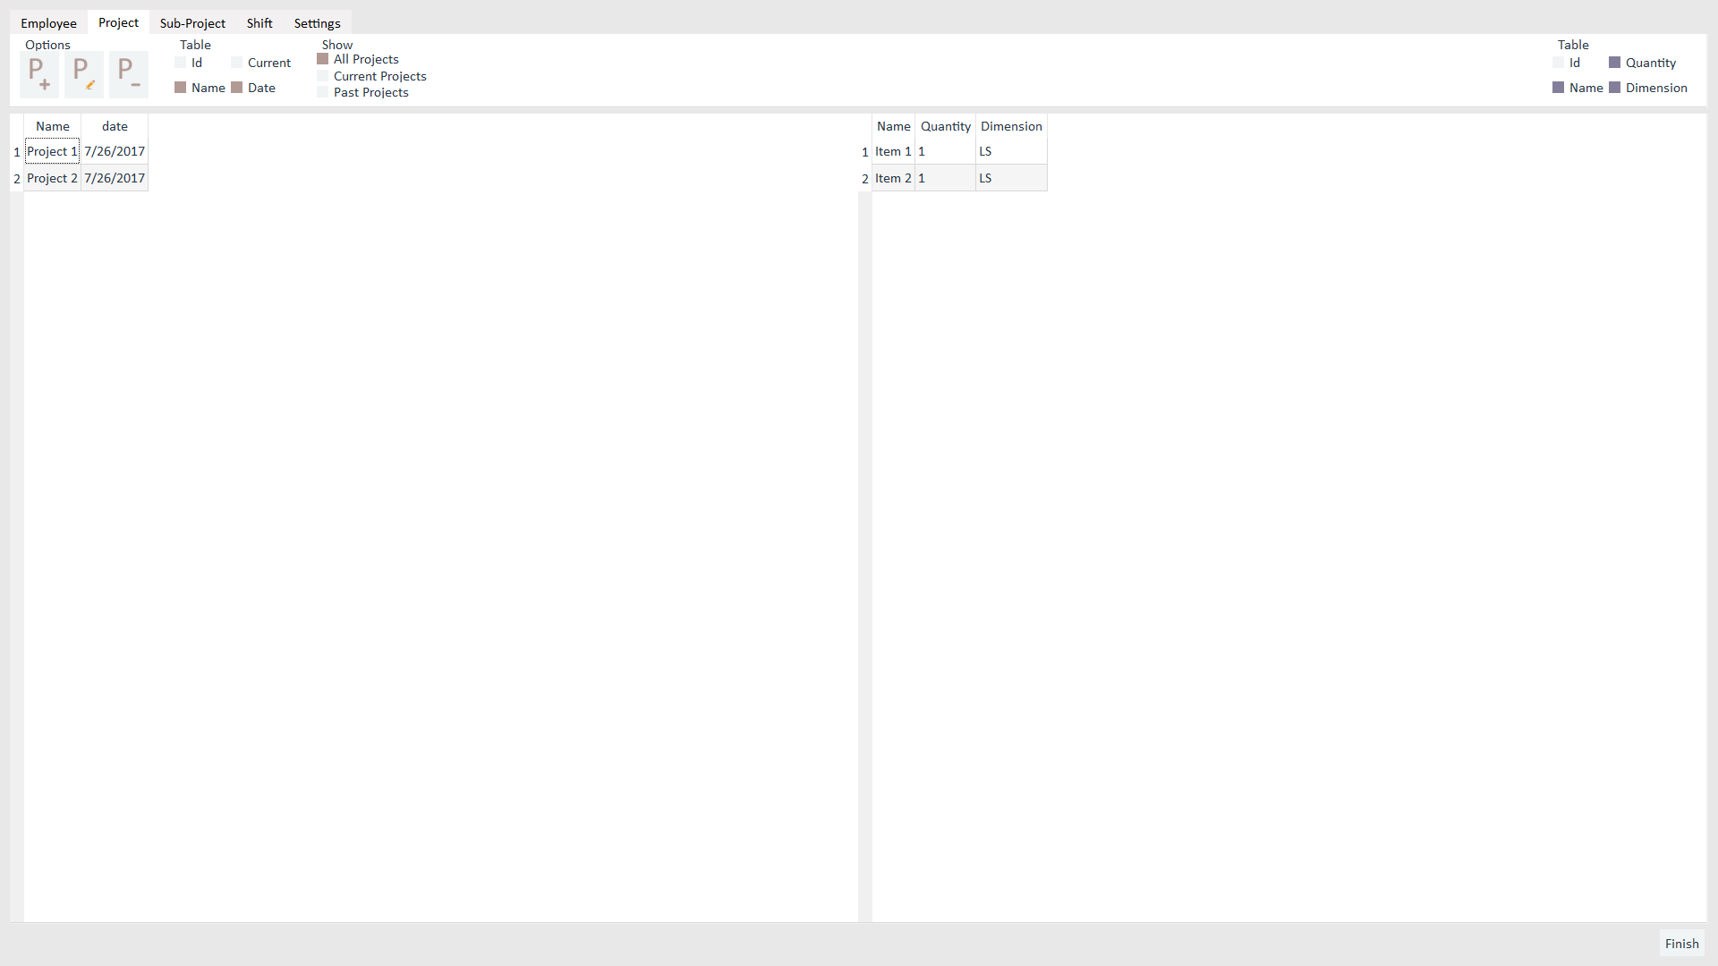
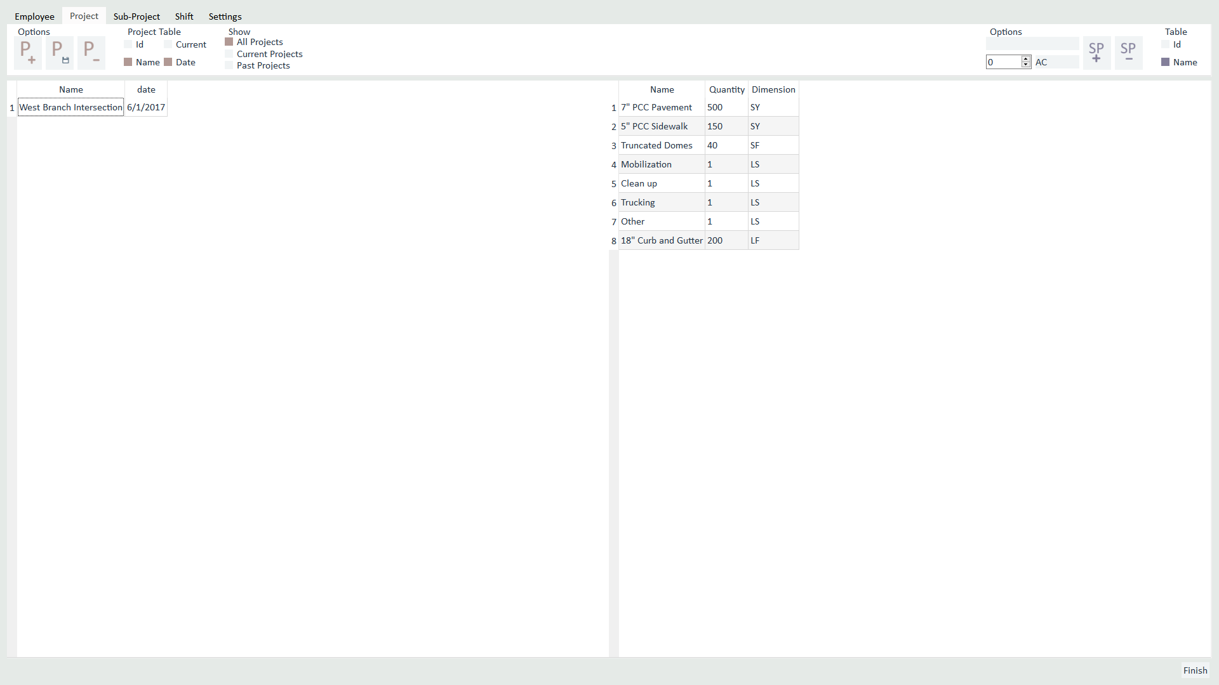
Tab two is called Project
Projects are displayed in the left hand table
Corresponding Sub-Projects are displayed in the right hand table

Slide 8
There are three Project functions
Add Project:
Click Add
Fill in blank slate inserted into the table
Edit Project:
Select Project from table
Click Edit
Delete Project:
Select Project from table
Click Delete

Slide 9
The Show sections lets you select what Projects are display
The Table section adjusts what Project properties are displayed

Slide 10
The Table section adjusts what Sub-Project properties are displayed

Slide 11
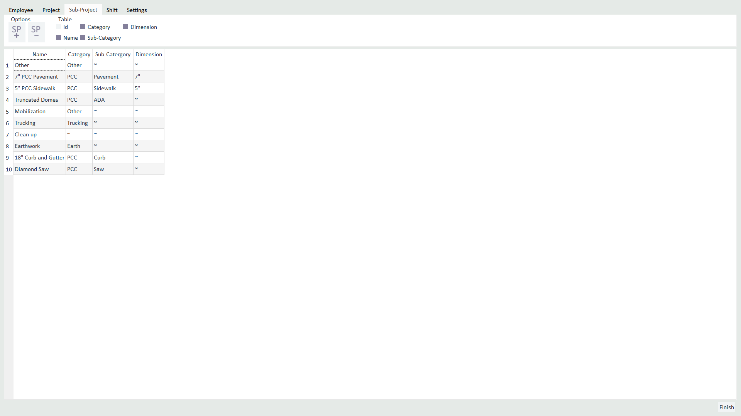
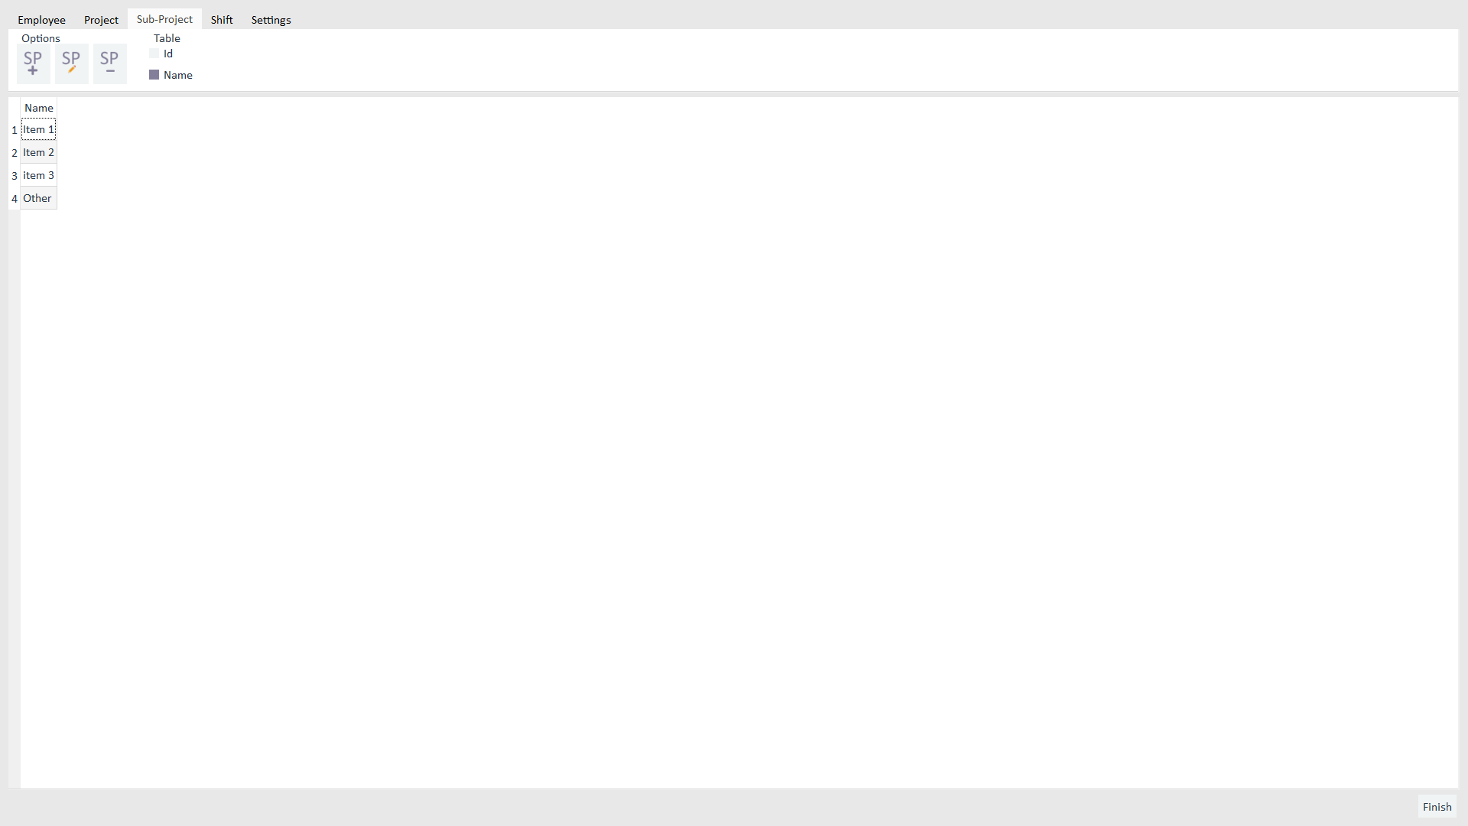
Tab three is called Sub-Project
Tab 3 is called Sub-Project
Sub-Projects are displayed in this table
Sub-Projects are displayed in this table
One key thing to understand is that this table and the right hand table in the Projects section are not the same.
This table shows you all Sub-Projects
The right hand table of the Projects section is just the Sub-Projects from this table that were added to that project

Slide 12
There are three Sub-Project functions
Add Sub-Project:
Click Add
Fill in blank slate inserted into the table
Edit Sub-Project:
Select Sub-Project from table
Click Edit
Delete Sub-Project:
Select Sub-Project from table
Click Delete

Slide 13
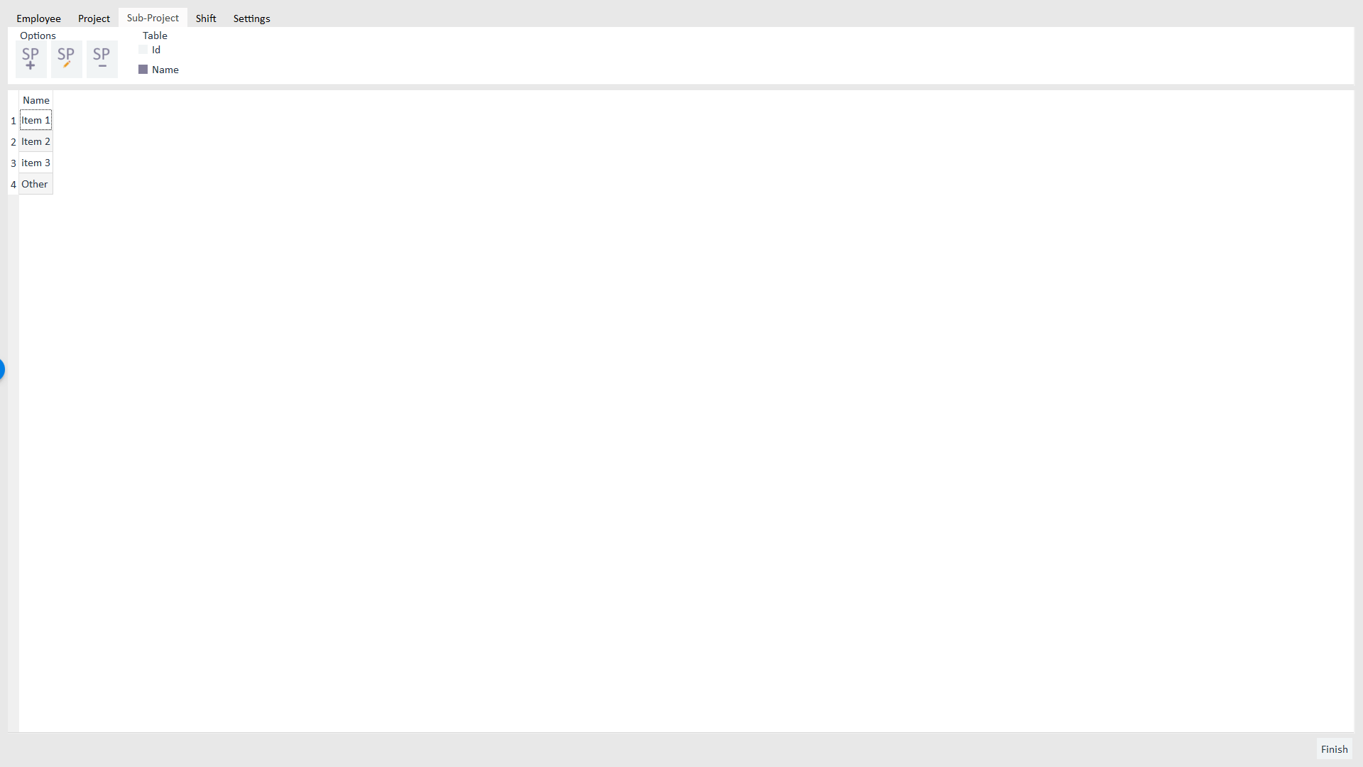
The Table section adjusts what Sub-Project properties are displayed

Slide 14
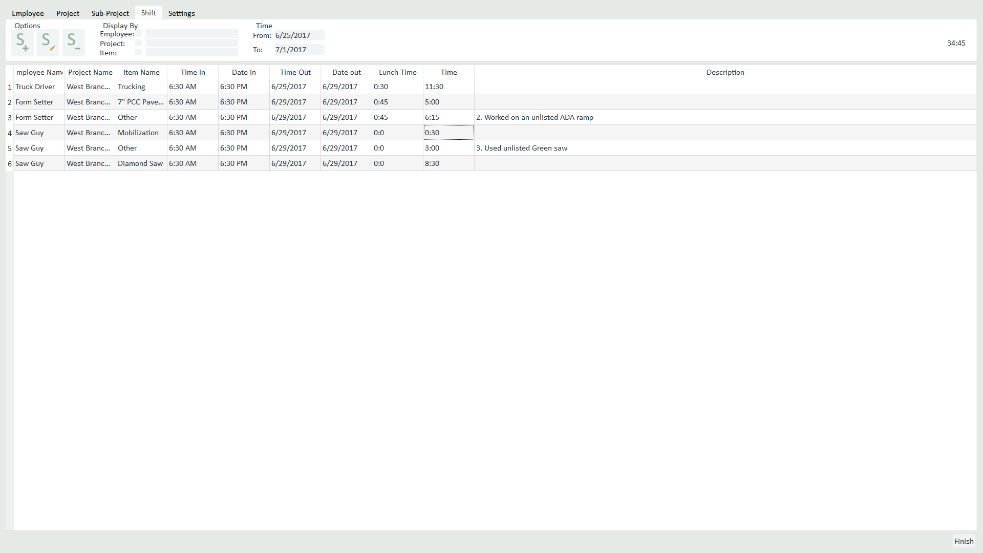
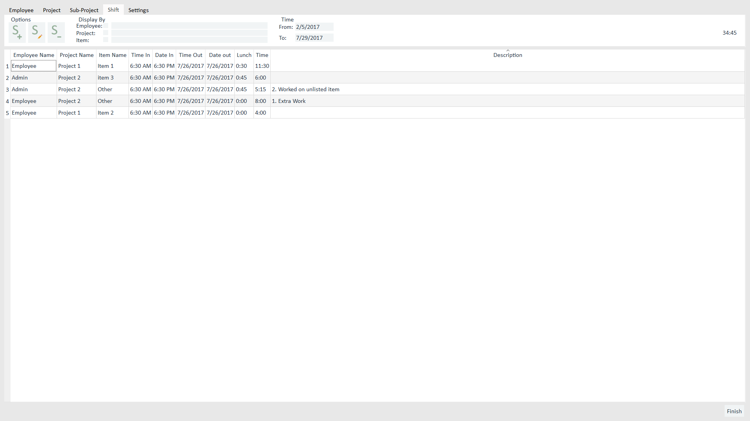
Tab four is called Shift
Shifts are displayed in this table

Slide 15
There are three Shift functions
Add Shift:
Click Add
Fill in provided dialog
Press finish
Edit Shift:
Select Sub-Project from table
Click Edit
Fill in provided dialog
Press finish
Delete Shift:
Select Shift from table
Click Delete

Slide 16
Note that a shift has as many rows as it needs for every thing that the person did
When you select a shift to Edit or Delete it you just have to click one of the rows for that shift.
So for this example you could click rows
2 or 3 in order to Edit the Admin’s Shift.

Slide 17
The Time section lets you set the time frame of shifts you want displayed
By default the current week is what is displayed
The Display By section adjusts what shifts are displayed
If you want to see only the Admin’s Shifts you check the box next to Employee and enter Admin into the line edit to the right

Slide 18
A summation of all displayed shifts can be seen here
This can be easily used to see how much time was spent on one Project or how much someone worked in a year. All you have to do is adjust the Display By and Time Sections to your preferred specification.

Slide 19
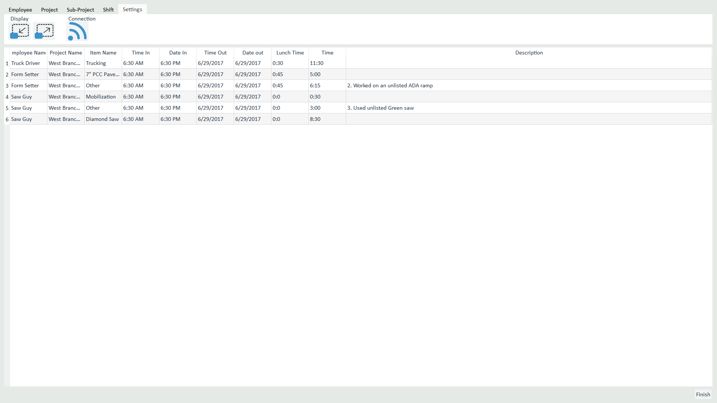
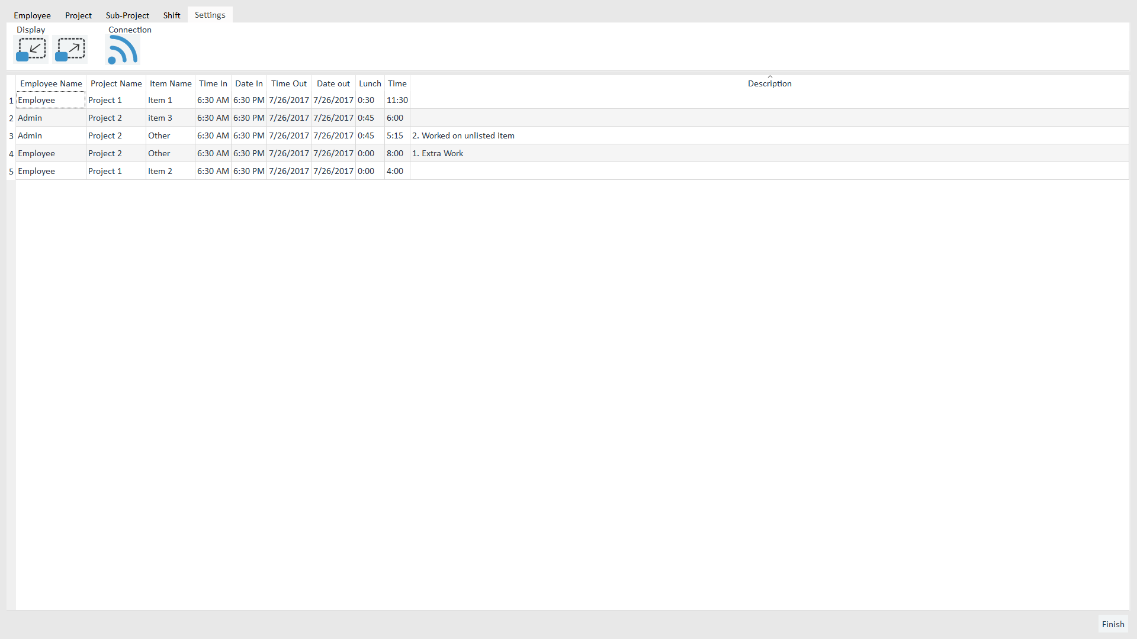
Tab five is called Settings
This doesn’t affect the current tab you are on
As of now there are only three options

Slide 20
The Connection section holds the Connection option
On your first use you set up the Connection settings. This button can be used if you connected to the wrong thing or want to adjust the connection.
The Display section holds the Full screen and Maximize options

Slide 21
With that you should be good to go.
If you have a question email me at Joshua@aaconcreteinc.com

